Slide 1


28 Jan 2026
Irua: A Cultural Journey
Irua: The Kikuyu Rite of Passage

Slide 2

Context of the Kikuyu
Understanding Kikuyu Culture and Society
The Kikuyu are the largest ethnic group in Kenya, known for their rich oral traditions, structured social systems, and the Irua rite as a pivotal cultural milestone.

Slide 3
What is Irua?
Understanding the Rite of Passage
Irua signifies male circumcision, marking the transition from boyhood to manhood. This rite encompasses physical, social, and spiritual transformations, vital for identity within Kikuyu culture.

Slide 4
Why Irua Matters
Understanding the significance of Irua
Irua is vital in Kikuyu culture, as it confers adult responsibilities and fosters community bonds, demonstrating courage and endurance, while enriching social identity and cohesion.

Slide 5
The Initiates
Young Men Embracing Their New Roles
The Irua rite primarily involves young boys aged 12 to 20, marking a significant transition as they are supported by family and community elders throughout the process.

Slide 6
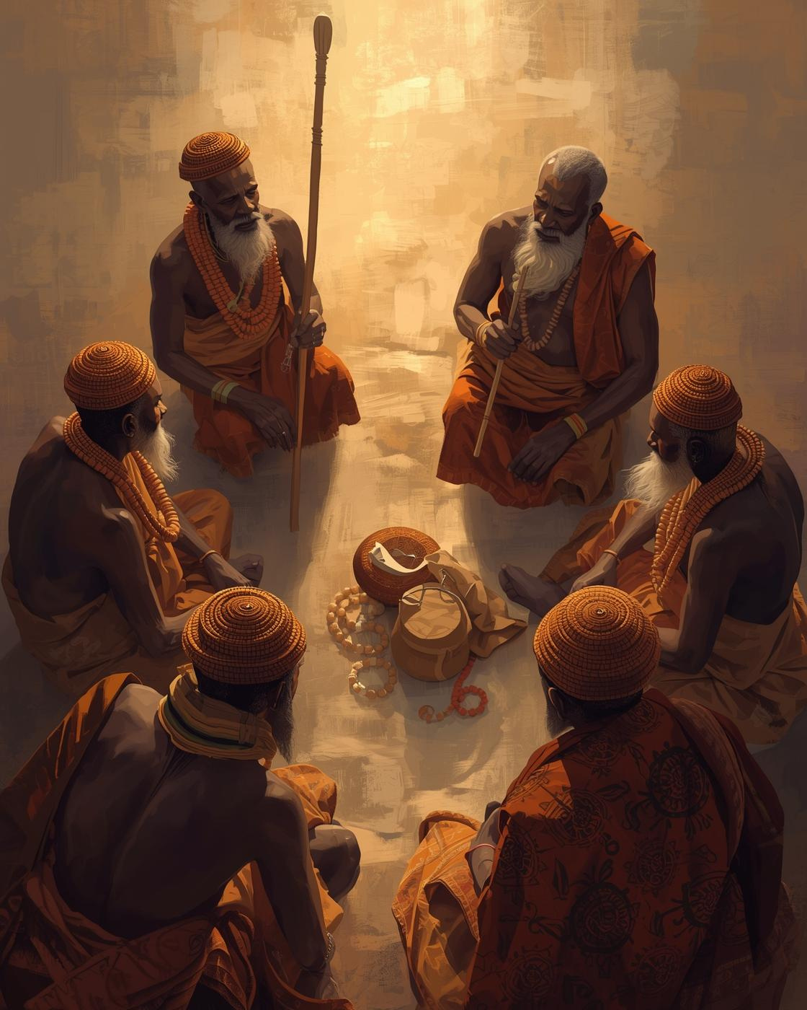
The Irua process includes preparatory teachings, ritual marking, and healing phases, emphasizing guidance from elders as initiates transition into adulthood, fostering cultural connection and identity.

Slide 7
The Role of Elders
Guiding Youth Through Cultural Transformation
Elders play a vital role in mentoring young initiates, teaching them cultural ethics and responsibilities while providing support and guidance throughout their transformative journey into adulthood.

Slide 8
Cultural Lessons
Core Values Imparted through Irua
The Irua rite instills vital values, including courage, community accountability, and respect for tradition, shaping the ethics and identity of the initiates as they transition into adulthood.

Slide 9
Irua Today
Modern Adaptations and Cultural Relevance
Irua has evolved to prioritize safety and ethics, focusing on cultural education. It preserves identity and communal values while adapting to contemporary societal norms.

Slide 10
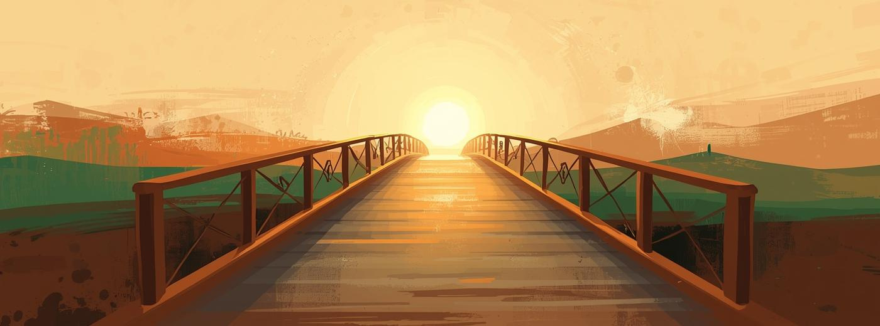

The Enduring Significance
A bridge between cultures

